Slide 1

Emergency Mobile App
By:
Ahmed Mohamed Fathi
Supervised by:
Ahmed Ezzat Labib

Slide 2

Chapter 1 Introduction

Slide 3

There are many situations that people want to get help from others, people can use their phone to call someone to get help but call in sometimes will not be helpful because maybe the one they call not respond that call or that one who want help can’t communicate or have time to wait the respond.

Slide 4
So that we may facing some problems in critical situations like:
How I get help in emergency situations like treating and kidnapping situations.
How to get help when car broke down in road.
How parents make sure that their kids safe outside and get their attention when they need help.
Need help in health issues.

Slide 5
We know that technology is more than a business enabler and enhancer so that it can also be a life saver. While we invest in the development of new software products for corporate clients in different markets, we also address the global individuals who rely on technology to achieve better life quality standards. Besides our telecom and mobile solutions, we always keep in mind that people also need high quality products to live better lives.

Slide 6

Chapter 2 Literature Survey and Market

Slide 7



Used Technologies in Project

Slide 8
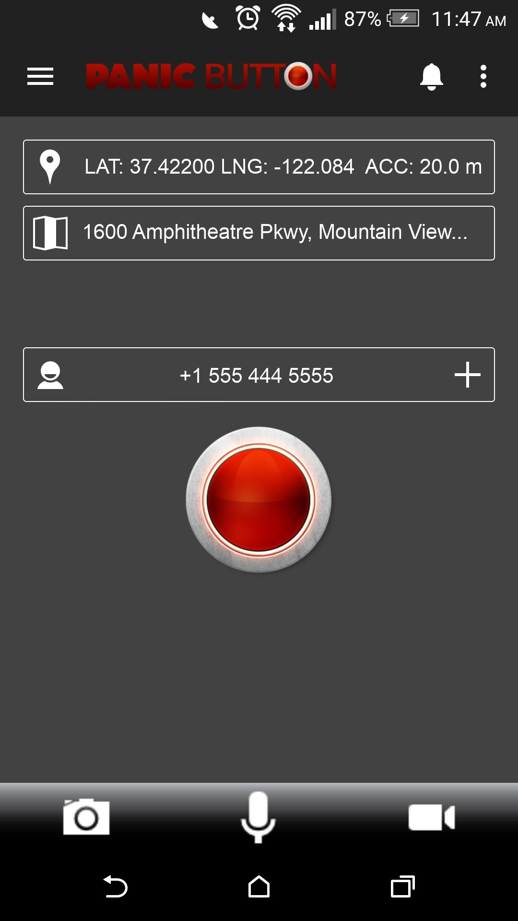
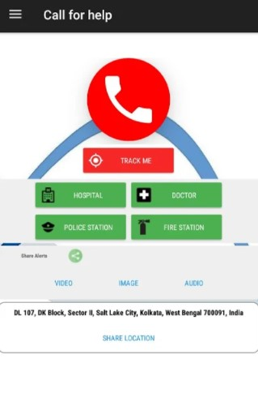
Similar Apps

Slide 9

Chapter 3 Methodology

Slide 10
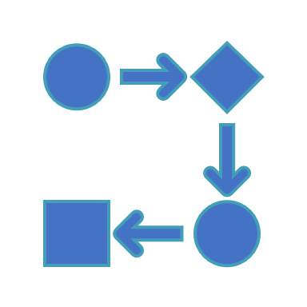
In this application we use a waterfall methodology to get successful application: The waterfall model is a classical model used in system development life cycle to create a system with a linear and sequential approach. It is termed as waterfall because the model develops systematically from one phase to another in a downward fashion.
Modeling Technical

Slide 11
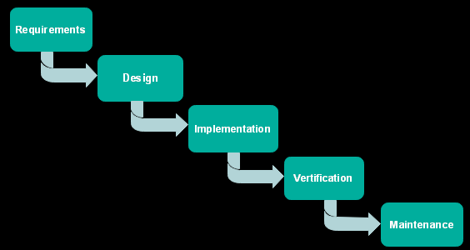
The waterfall model is a project management methodology that has at least five to seven phases that follow in strict linear order, where a phase cannot begin until the previous phase has been completed.
Waterfall methodology

Slide 12
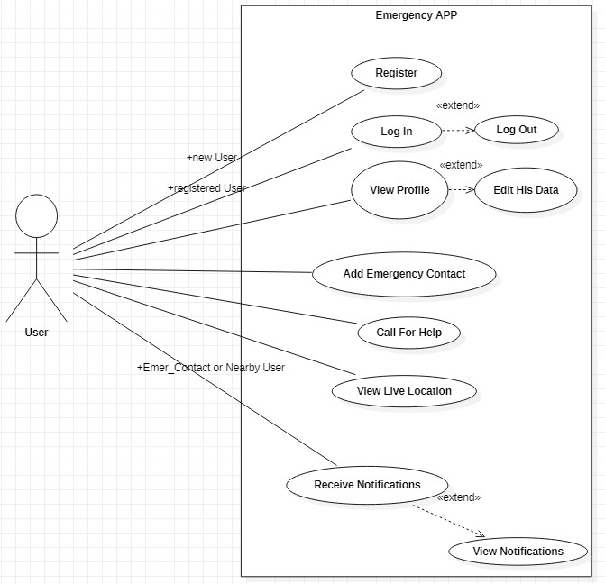
UML Diagram

Slide 13

Chapter 3 Experimental work

Slide 14
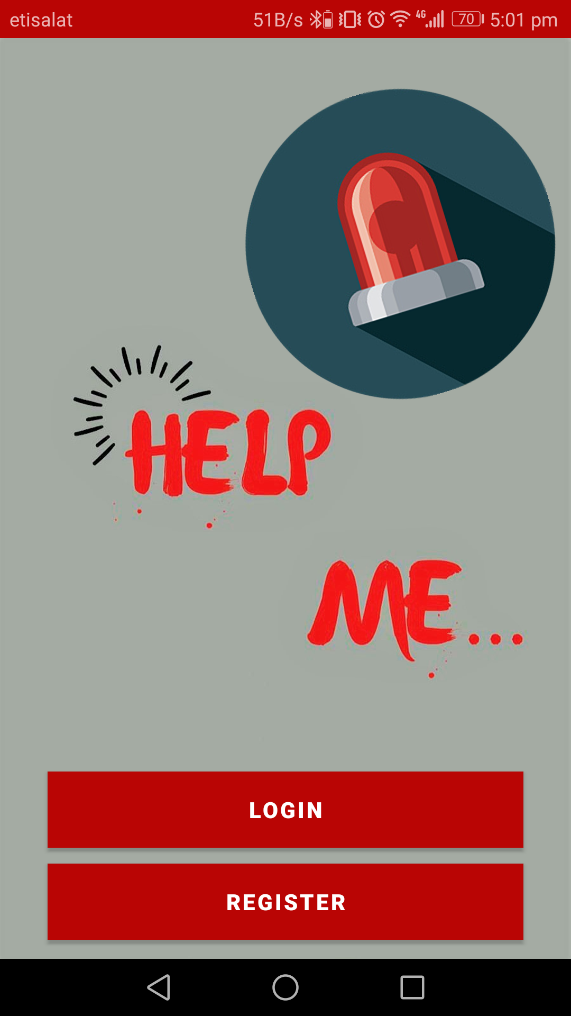
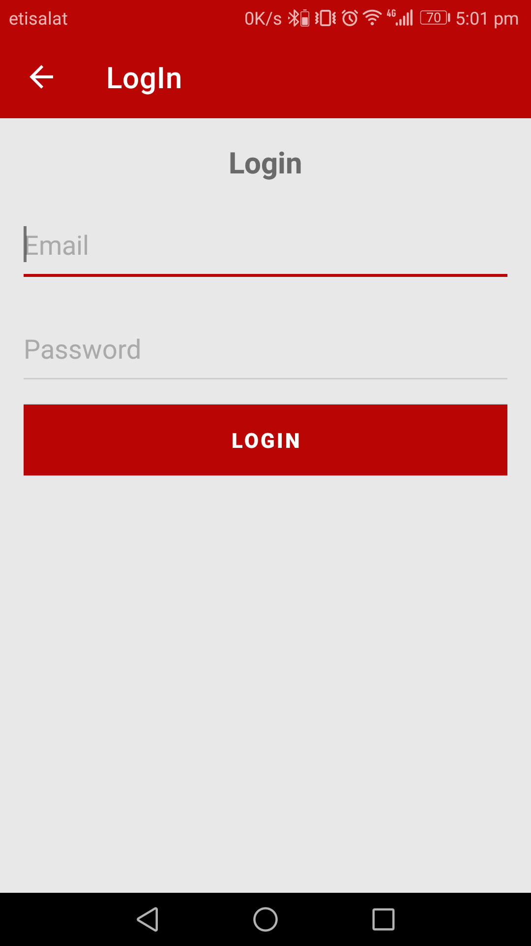
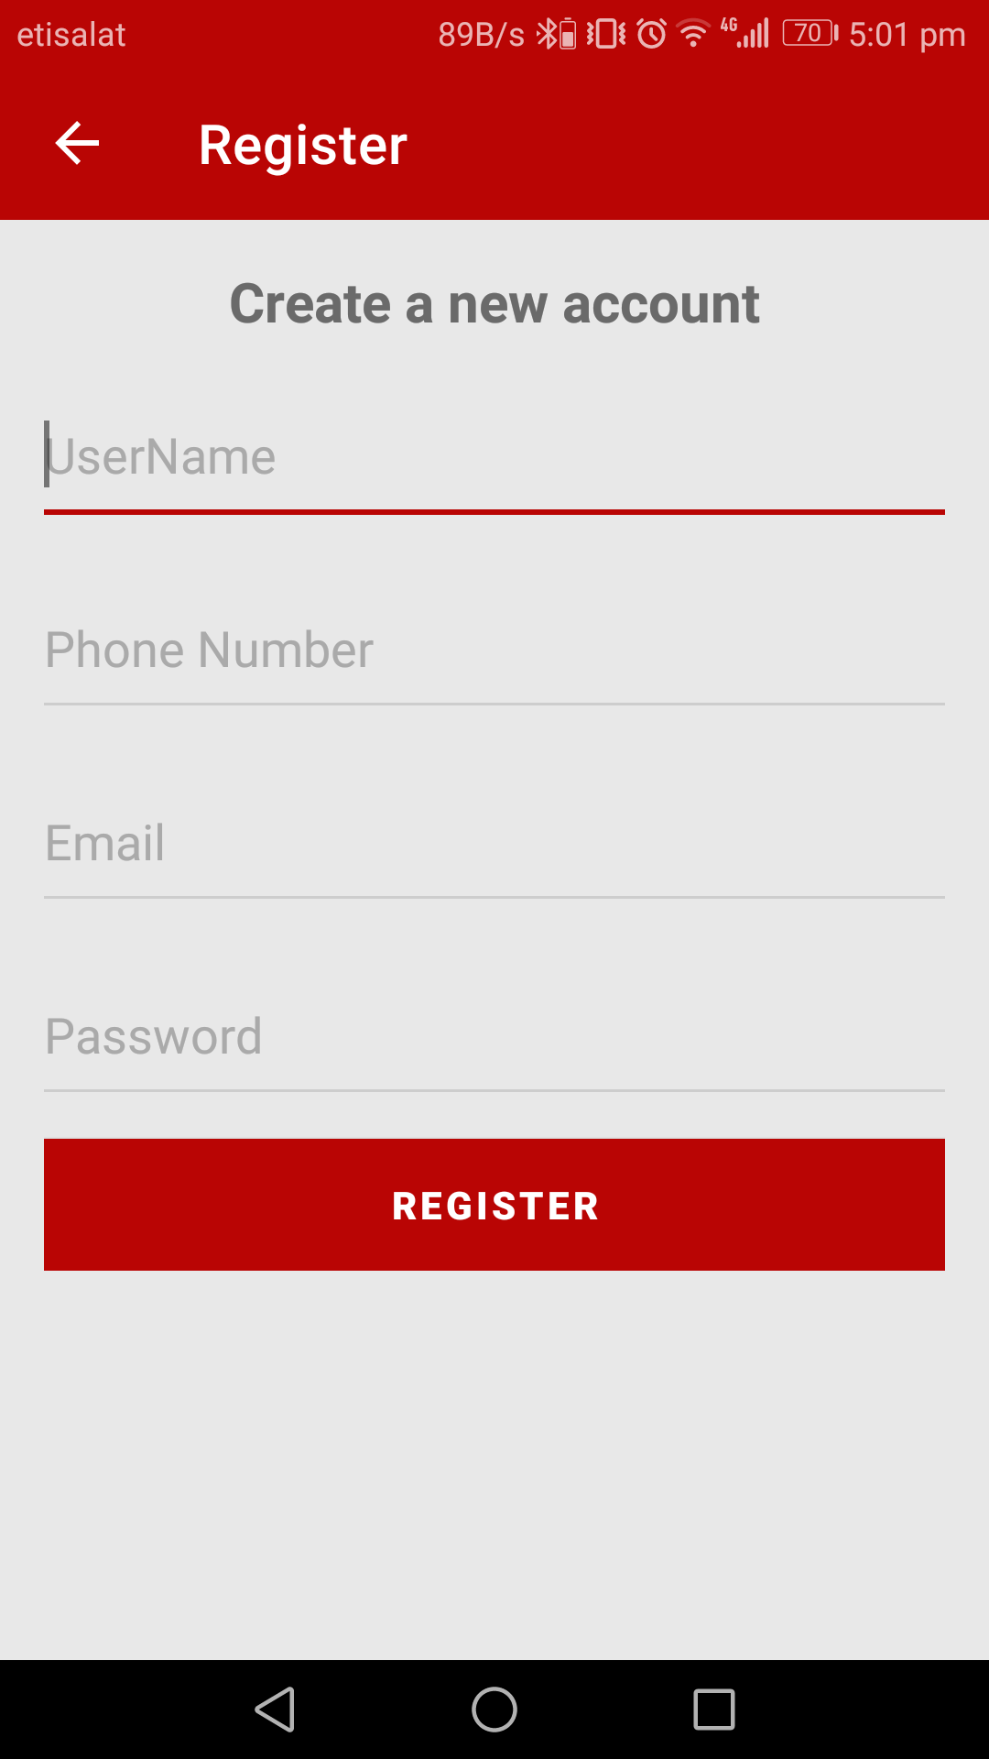
Starting Screens
Start Screen
Login Screen
Register Screen

Slide 15
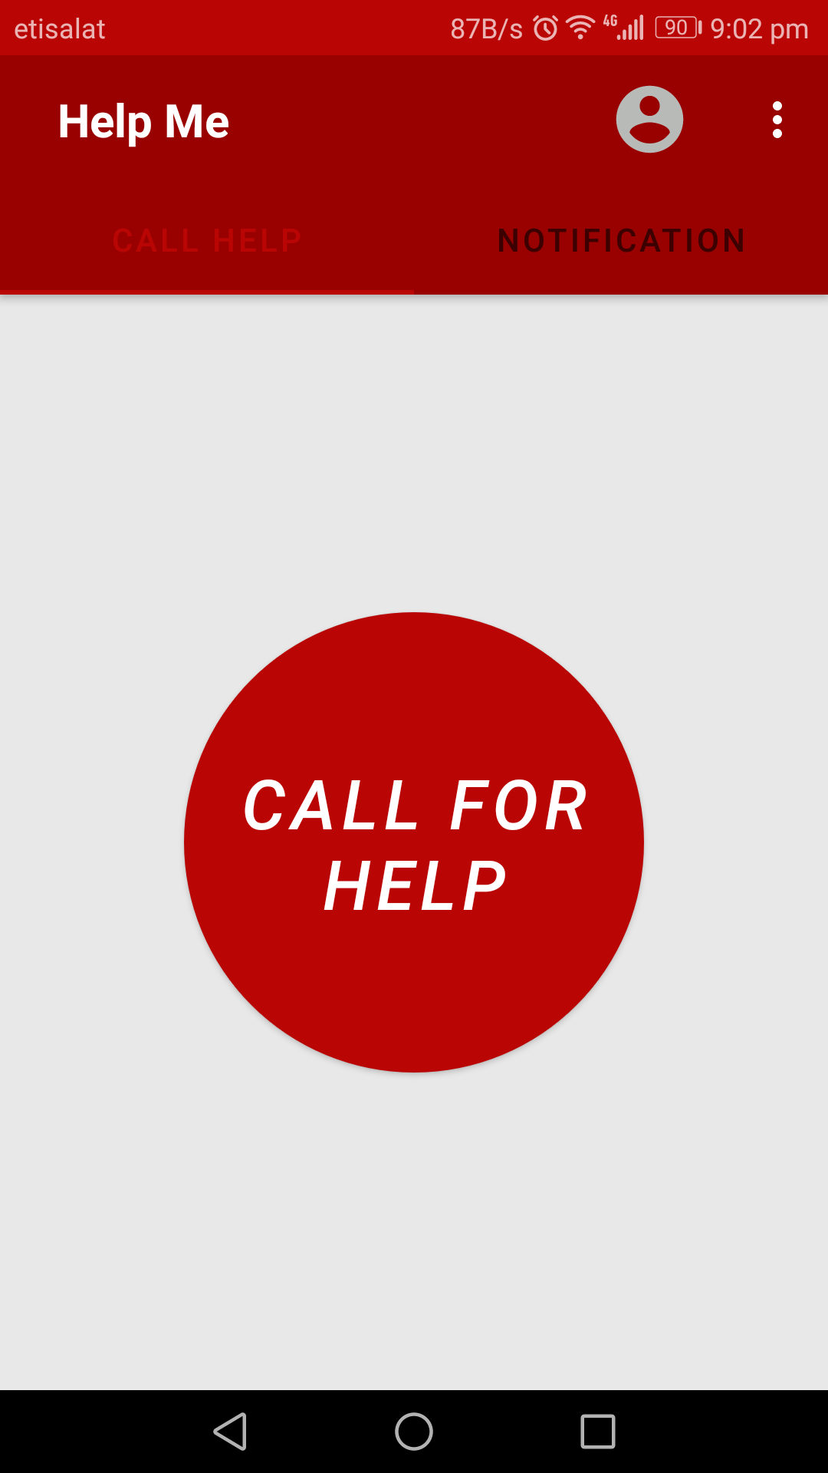
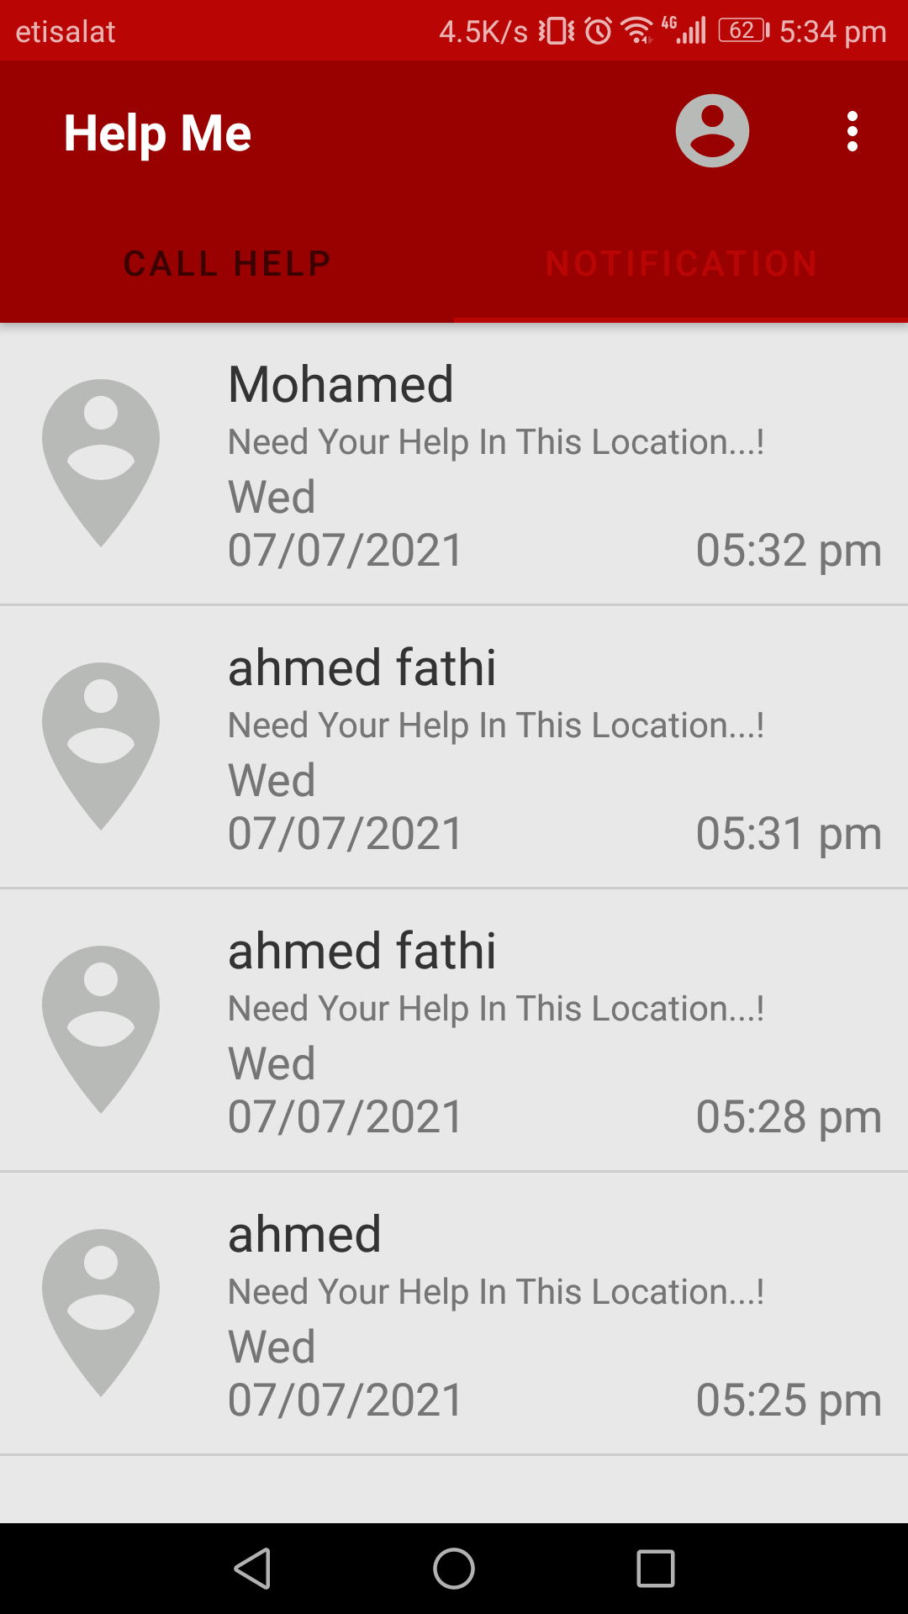
Main Screens
Call Help Screen
Notification Screen

Slide 16
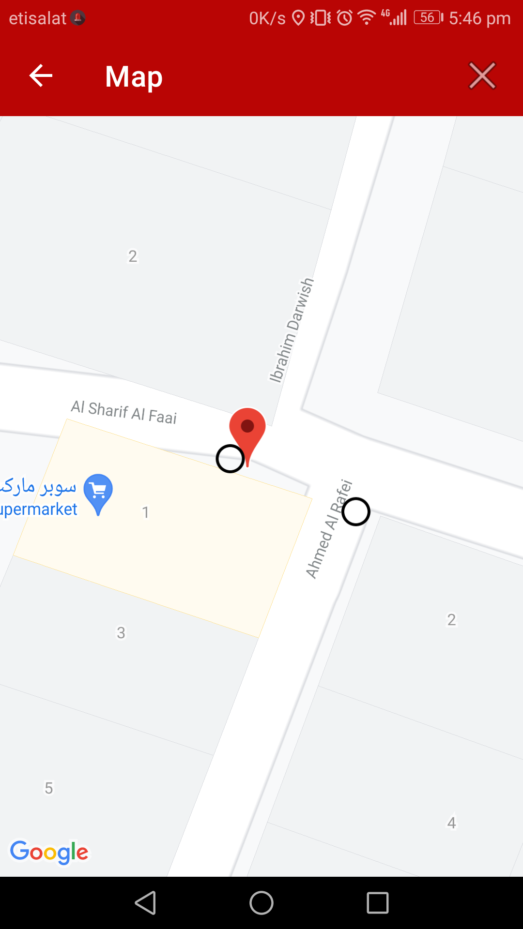
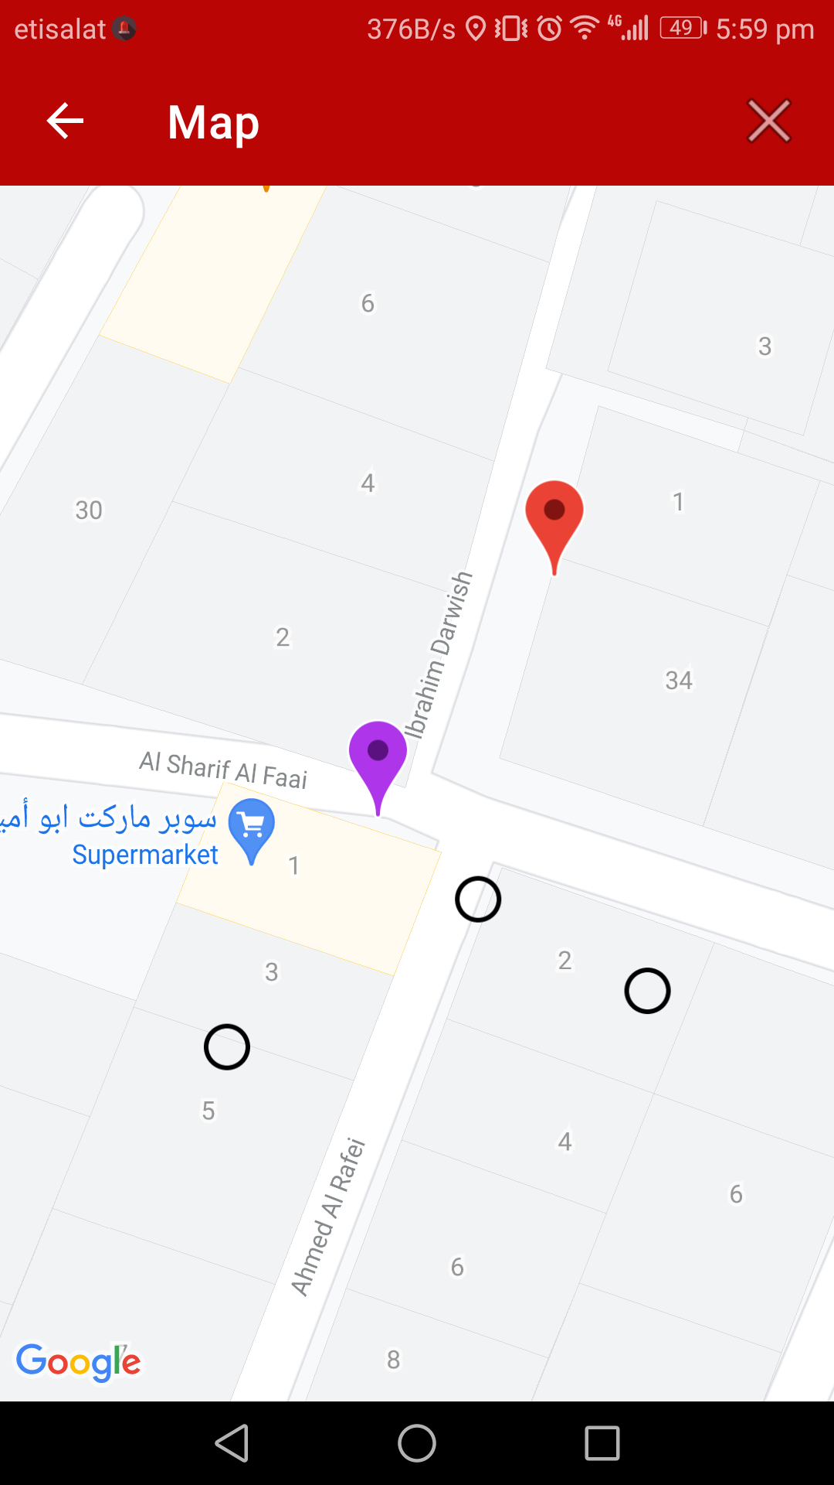
Map Screens
Map Screen
for user who want help
Map Screen
for other users (viewers)

Slide 17
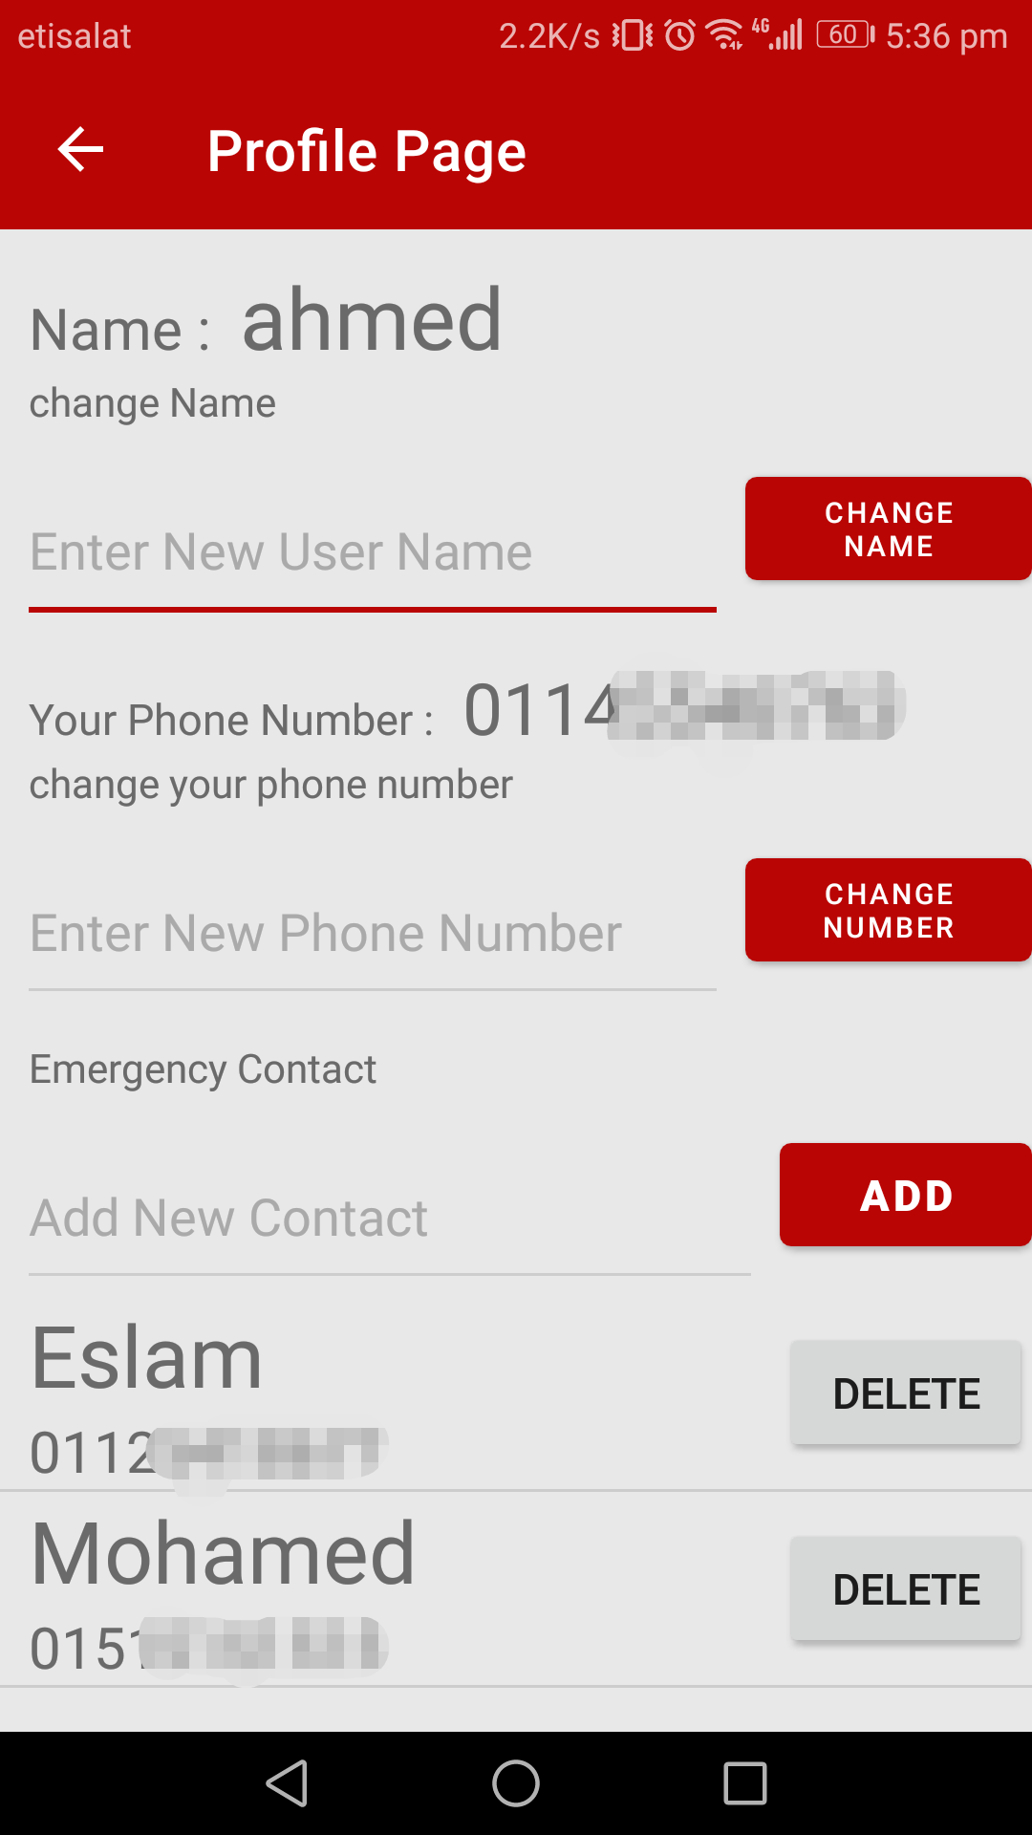
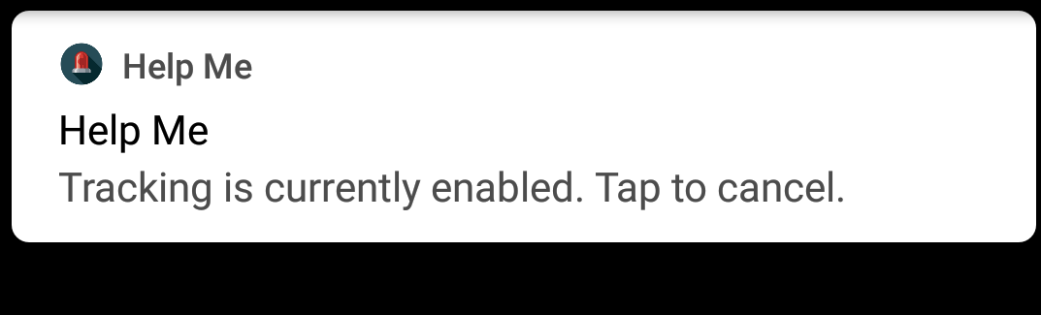
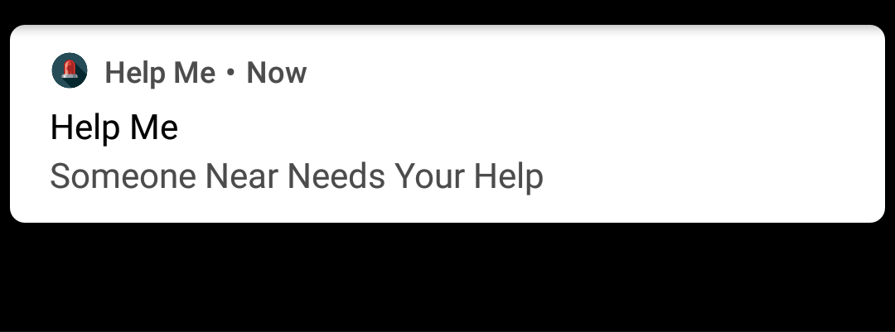
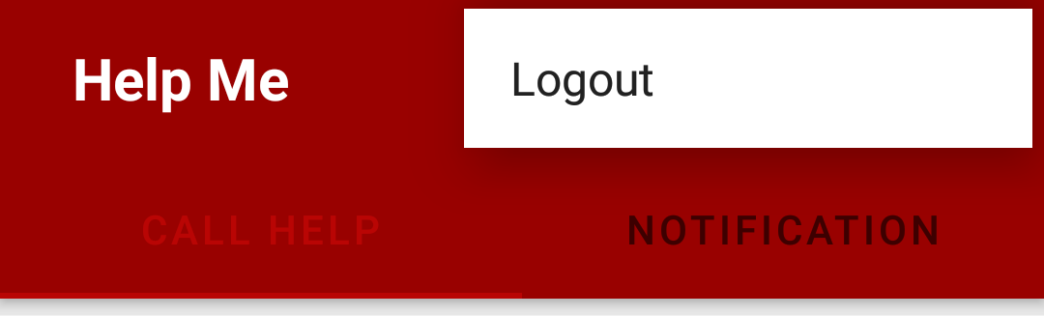
Profile Screen and Logout
Profile Screen
Tracking notify
Ask for help notify
Logout

Slide 18

Further work

Slide 19

THANK YOU

